Slide 1
Visual AI Tools: Enhancing Creativity and Security in the Oil Sector
Exploring AI-Driven Image Generation and Deepfake Detection

Slide 2
Introduction to Visual AI
Artificial Intelligence technologies that enable machines to interpret, generate, and manipulate visual content.
Importance: Streamlines workflows, enhances creativity, and bolsters security measures.

Slide 3
AI Image Generation Overview
Purpose: Create images from textual descriptions AKA Prompts
Applications: Marketing materials, training simulations, conceptual designs.
‘graphic designers’

Slide 4
How AI Generates Images
Process:
1. Input: Text prompt (e.g., ‘Make a picture sunset over the Asmara’s Skyline').
2. Model interprets the prompt using trained data.
3. Output: Generated image matching the description.

Slide 5
Deepfakes Explained
Definition: AI-generated or manipulated media that replaces a person's likeness with another's.
Risks: Misinformation, security breaches, reputational damage.
Benefits: Education, Simulation, Training…

Slide 6
Applications of Deepfakes
Entertainment: Celebrity likeness in film
Education: Animated historical figures for learning.
Historical Reenactments: Reviving figures from history for educational purposes

Slide 7
Open-Source AI Tools for Image Generation
Leonardo.Ai (Free Tier)
Strengths: High-quality photorealistic and artistic styles, custom model training.
Free Plan: Limited daily credits, enough for casual use.
Website: https://leonardo.ai
BlueWillow AI
Strengths: Midjourney-style generation via Discord, simple prompt system.
Free Plan: Unlimited generations but queued processing during peak times.
Website: https://www.bluewillow.ai
Craiyon (formerly DALL·E Mini)
Strengths: 100% free, unlimited generations, runs in your browser.
Free Plan: No signup needed, but slower and lower resolution than premium tools.
Website: https://www.craiyon.com

Slide 8
ComfyUI
Description: A node-based interface for Stable Diffusion.
Features: User-friendly, modular workflow, supports extensions.
Use Cases: Streamlining image generation processes.

Slide 9
Fooocus
Description: An intuitive interface for Stable Diffusion XL.
Features: Predefined styles, GPT-2 integration for enhanced prompts.
Use Cases: Rapid image creation with minimal setup.

Slide 10

Quiz Time
Real or Fake?

Slide 11

Quiz Time…
Real or Fake?

Slide 12
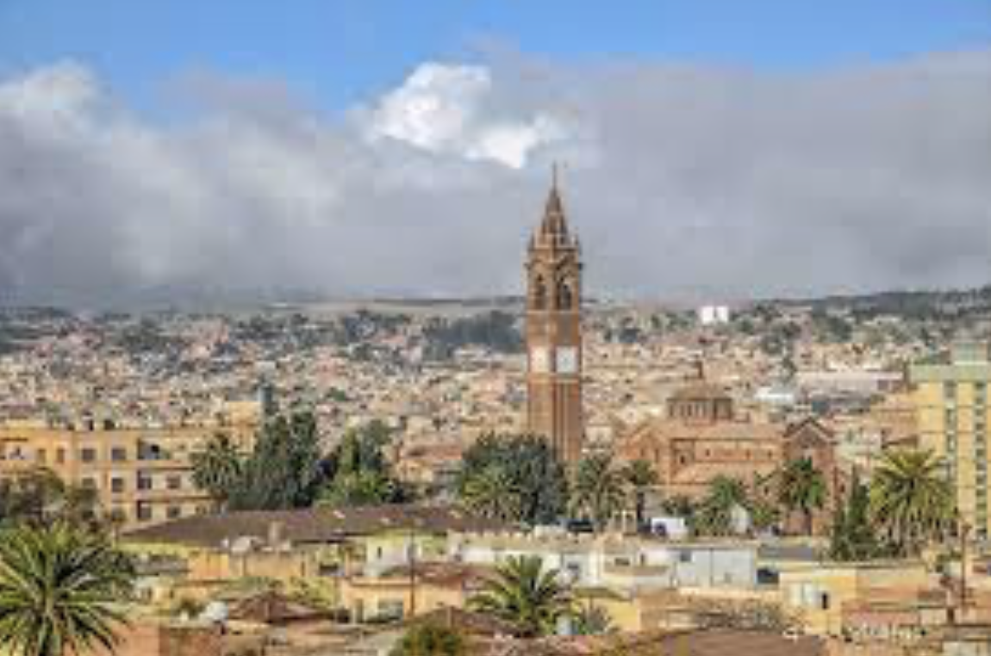
Quiz Time..
Real or Fake?

Slide 13
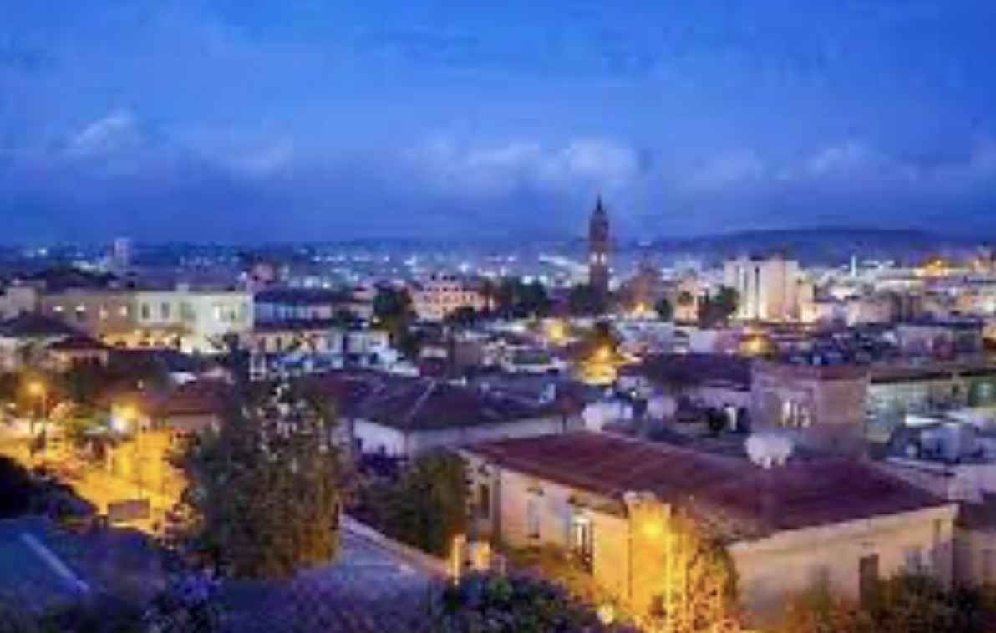
Quiz Time…
Real or Fake?

Slide 14

Final one…
Real or Fake?

Slide 15
Deepfake Detection Tools
Importance: Identifying and mitigating risks associated with deepfakes.

Slide 16
DeepSafe
Description: A web application for deepfake detection.
Features: Multi-model support, image and video analysis, GPU acceleration.
Use Cases: Verifying media authenticity in corporate communications.

Slide 17
Deepstar
Description: An open-source toolkit for deepfake detection.
Features: Community-driven, adaptable, supports various detection techniques.
Use Cases: Enhancing security measures in digital content.

Slide 18
TrueMedia.org
Description: A platform offering deepfake detection models.
Features: Free tools, focuses on political deepfakes, supports fact-checking.
Use Cases: Ensuring media integrity in public communications.

Slide 19
Implementing AI Tools in the Oil Sector
Benefits:
- Enhanced training simulations.
- Improved marketing materials.
- Strengthened security protocols.

Slide 20
Considerations for Adoption
Challenges:
- Infrastructure requirements.
- Data privacy concerns.
- Training and skill development.

Slide 21
Case Study: AI in Oil Sector
Scenario: Using AI-generated images for equipment maintenance training.
Outcome: Improved training efficiency and reduced errors.

Slide 22
Future of Visual AI in the Oil Sector
- Integration with augmented reality (AR).
- Real-time deepfake detection in communications.
- Advanced predictive maintenance using AI-generated simulations.

Slide 23
Best Practices for Using AI Tools
Recommendations:
- Regularly update models.
- Ensure data privacy compliance.
- Provide staff training on tool usage.

Slide 24
Conclusion
Summary: Visual AI tools offer transformative potential for the oil sector.
Call to Action: Explore and implement these tools to enhance operations.

